Slide 1
Game Engine Final Demonstration
By: Bryce Tingle

Slide 2
Achieved 40% criteria
FPS Camera
Load models from a file
Load in 5 different models
Terrain
Controls with mouse and keyboard
Applied UV textures

Slide 3
Achieved 50% + criteria
Custom model loader
Implemented 5 billboards
Terrain with height map implemented
Fog
Skydome (explained)
Instancing
Particle Systems
Light and Shadows

Slide 4
Adjusted from original
Text for level feedback
HUD
These were replaced with:
Custom Model loader
Instancing

Slide 5
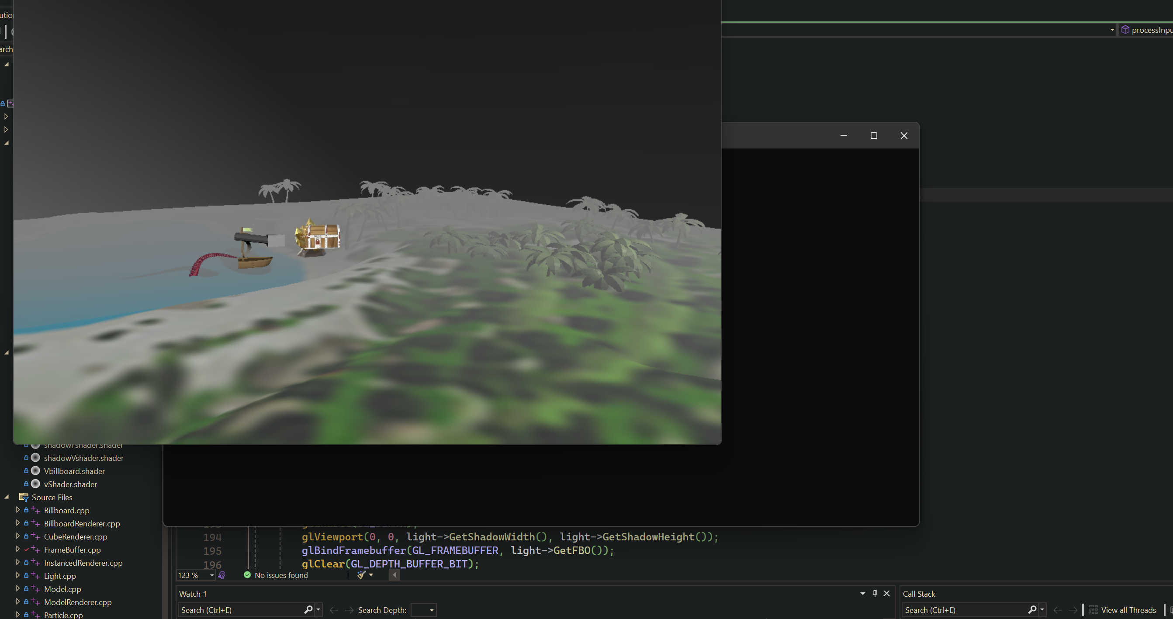
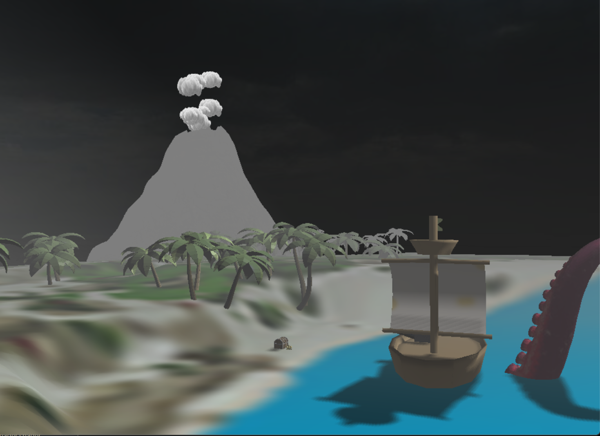
Scene Screenshots
Fig 1.0: Scene from a distance for billboards
Fig 1.1: Scene close including particles and shadows

Slide 6
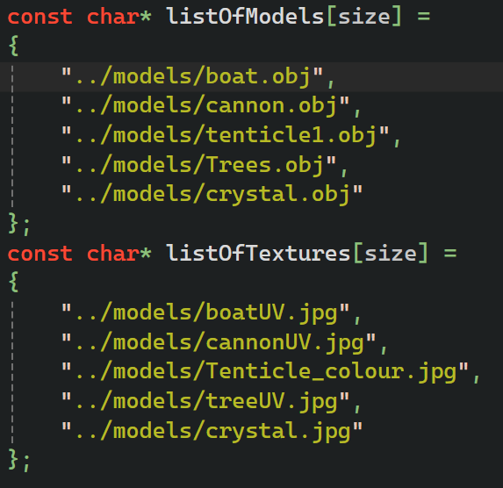
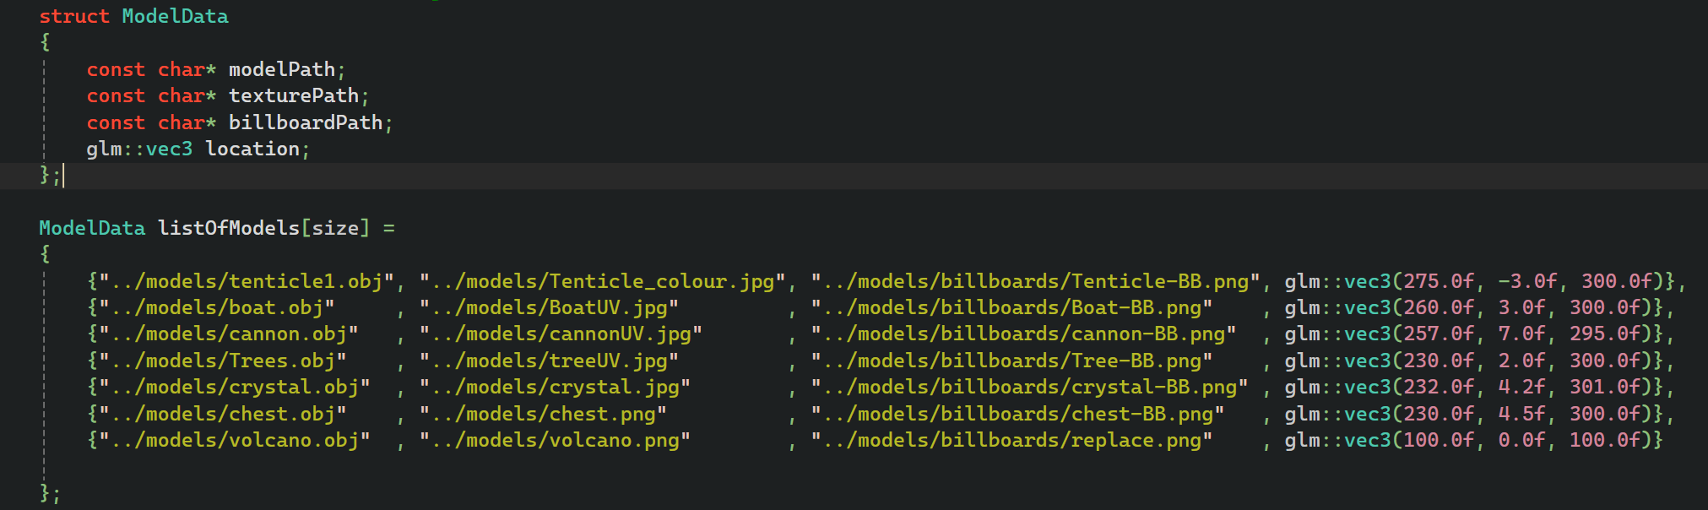
Loading models improved
These lists have been condensed into one struct of information representing the models, and then represented by a list of modelData
Fig 2.0: game engine file model list modification

Slide 7
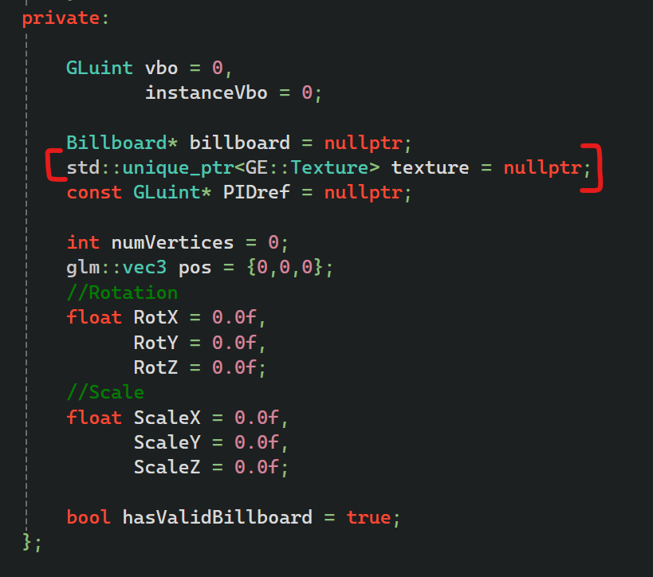
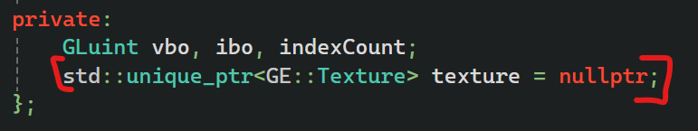
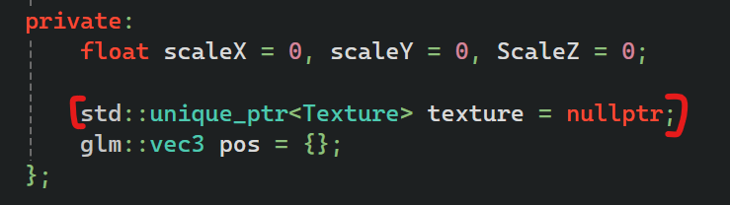
Textures
Texture ownership is included in the objects that need textures, such as models, terrains, skyboxes, billboards, and particle systems
Fig 3.1: Billboard file
Fig 3.2: Terrain file
Fig 3.0: Model file

Slide 8
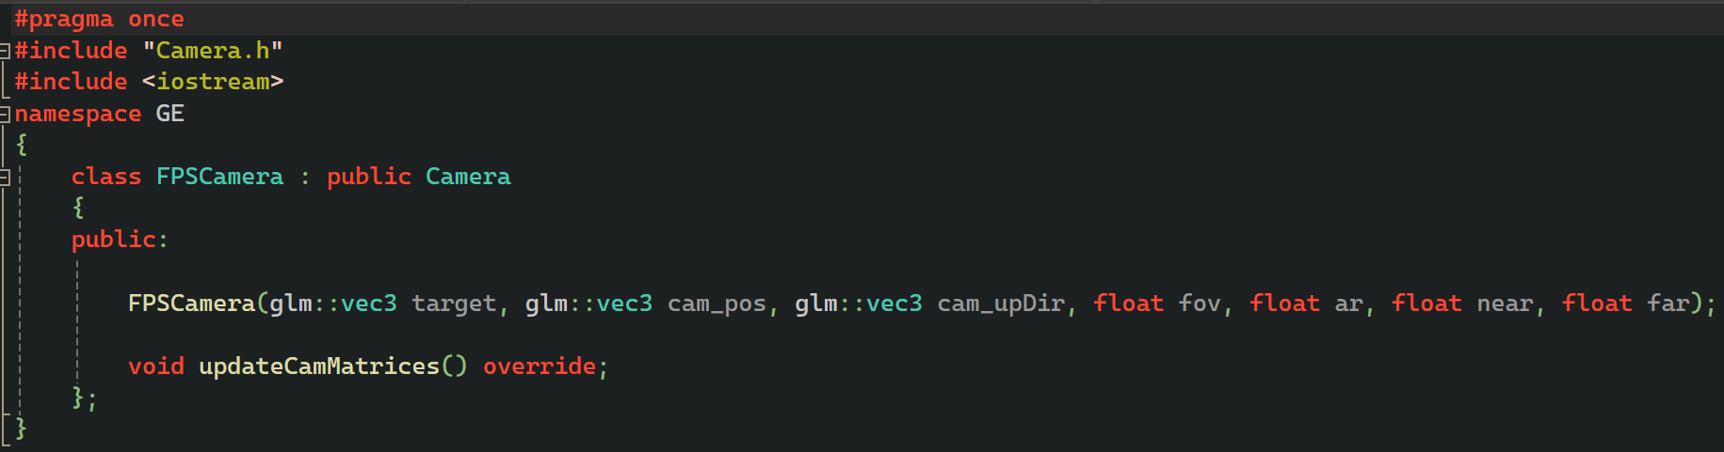
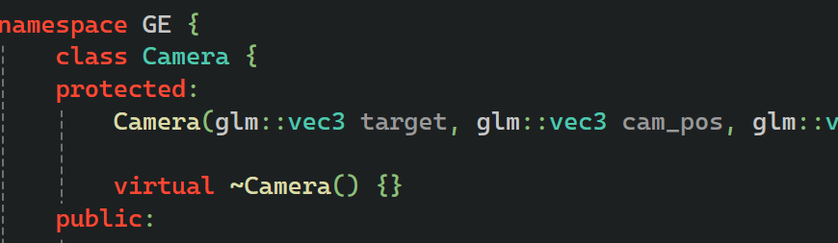
FPS Camera
The FPS camera has not changed from the previous presentation. Default camera class cannot be instantiated, this was intended to protect the base class for a potential 3rd person camera.
Fig 4.0: Camera inheritance class

Slide 9
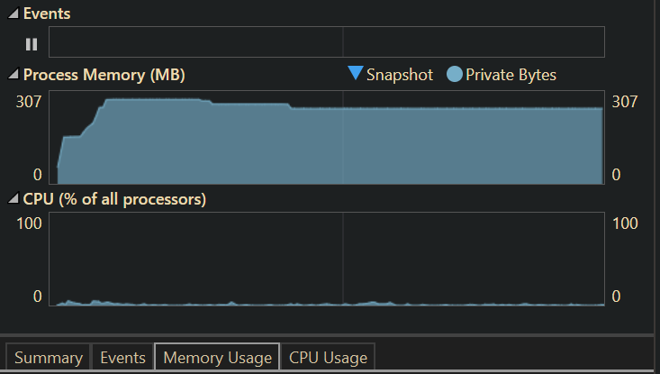
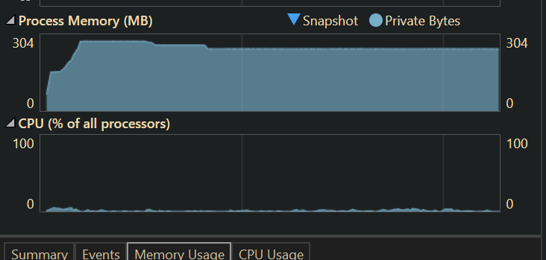
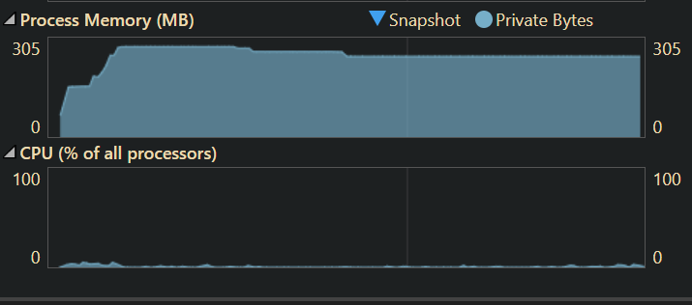
Sky dome or Skybox
With the skybox using up more memory and the sky dome using slightly more CPU usage in the beginning – the trade off was a slightly longer loading up time for total memory usage so the Skydome was used
Additional testing with Triangle strips and fans yielded inconsistent differences in performance, as well as blending the texture and drawing half the sphere
Fig 5.0: Memory profiles for different sky dome implementations

Slide 10
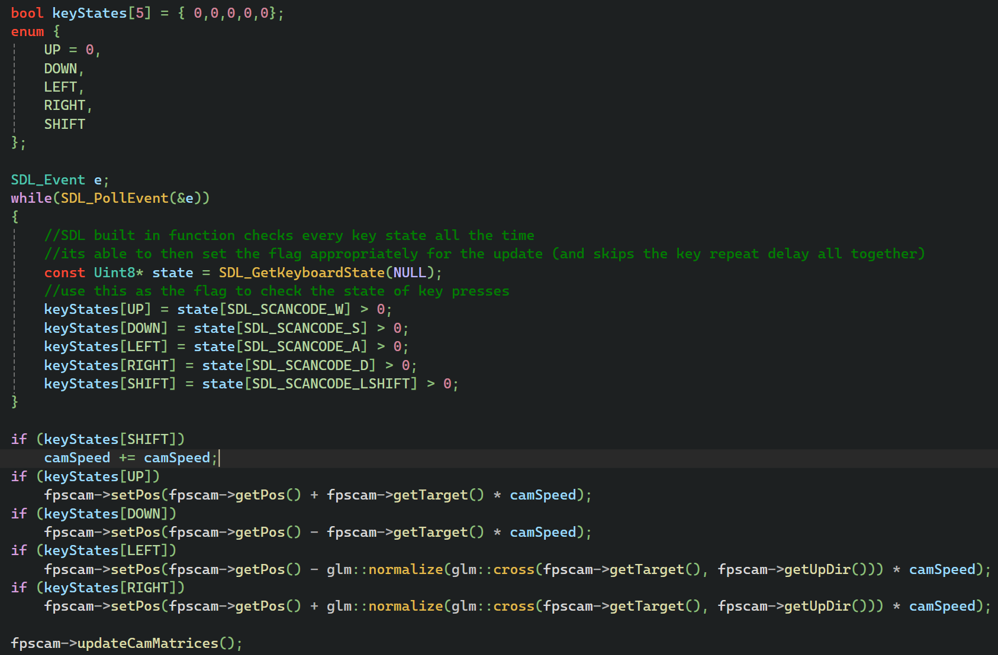
Controls and input
Using keyboard states allow smooth movement when keys are used to move
And the appropriate rotations and positions are updated by the camera
Pitch is locked so the player cant go upside down
And a speed up is implemented to move around the scene faster
Fig 6.0: Process input using WASD and Shift

Slide 11
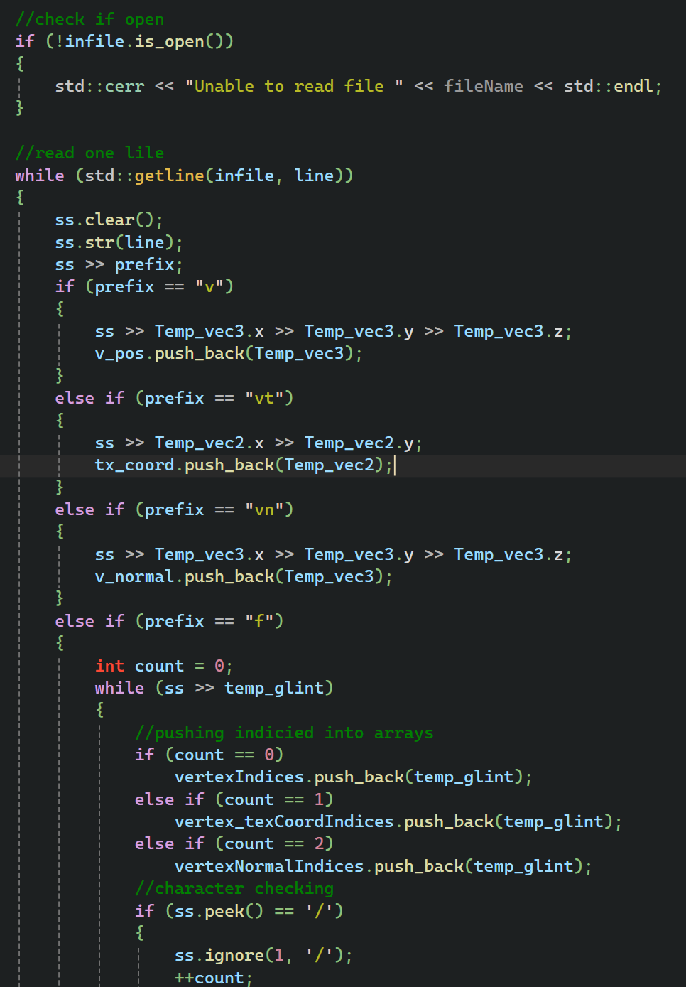
Custom Model Loader
Using stringstream an OBJ file is read into the program line by line
Using the prefixes v, vt, vn and f to extract relevant data.
Temporary arrays are used to store data included position, normals and textures.
Finally using the faces to populate the correct information into each vertex. This is important for mapping to OpenGL information correctly.
This version is lighter weight than assimp and is consistently cheaper to run on multiple tests
Fig 7.0: Reading from OBJ files

Slide 12
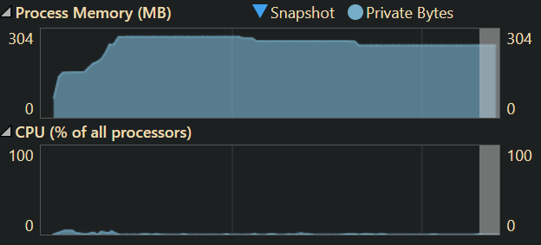
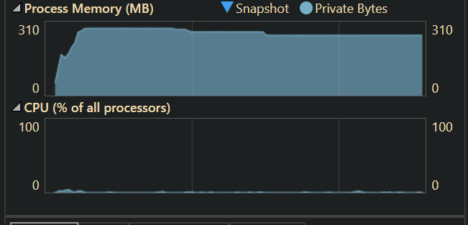
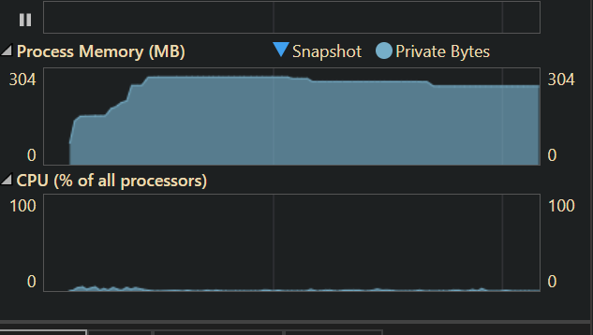
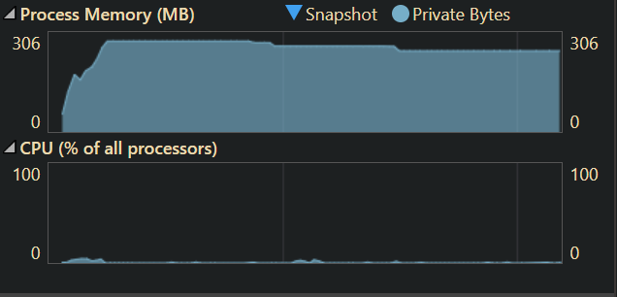
Custom Model Loader
Fig 7.0: Custom loader
Fig 7.1: Assimp loader

Slide 13
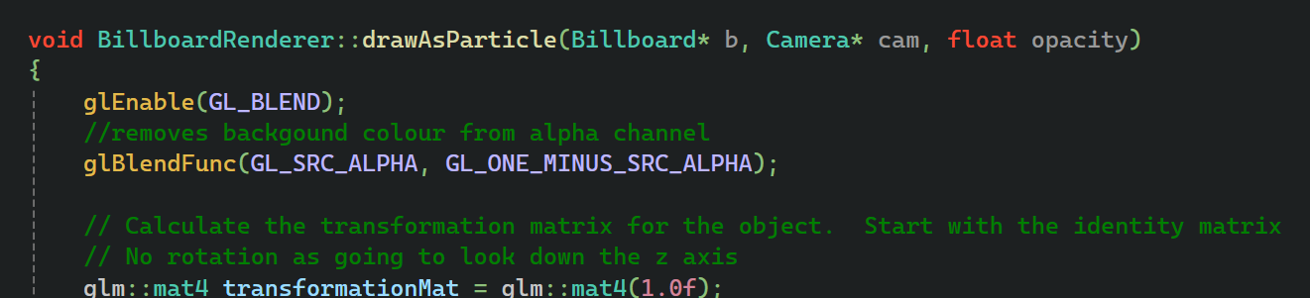
Billboards
Billboards were added to replace models after a certain distance to reduce processing models from a distance
Parameters such as having a valid billboard as well as using the model locations to place them were used to represent them in the correct places and distances
Also images were manually flipped in the image so OpenGL did not have to do this at runtime
They were also modified to be used by the particle system
Fig 8.0: In level billboards
Fig 8.1: Particle modification

Slide 14


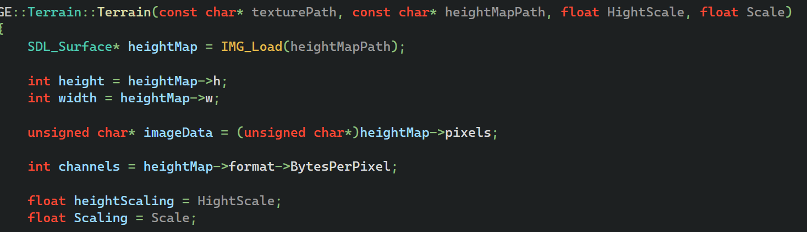
Terrain using height maps
Similar to the Skydome, triangle strips and fans were tested for performance with negligible difference on my machines
A height map is used to change the positions of the vertices based on the height map colours, darker indicating a lower section
Fig 9.0: textures used
Fig 9.1: height map implementation

Slide 15
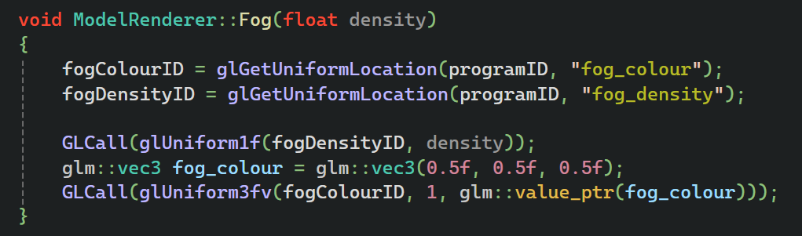
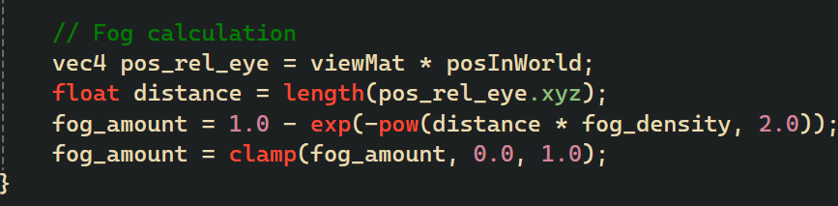
Fog
Fog is added by creating an exponential gradient of a fixed colour that is additive over distance from objects in the scene
The sky dome texter was also manipulated to create a more consistent effect in the scene
Method was extracted for reuse
Fig 10.0: Fog in scene displaying over distance
Fig 10.1: calculation in the vertex shader

Slide 16
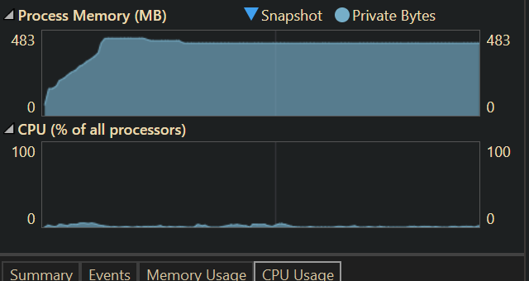
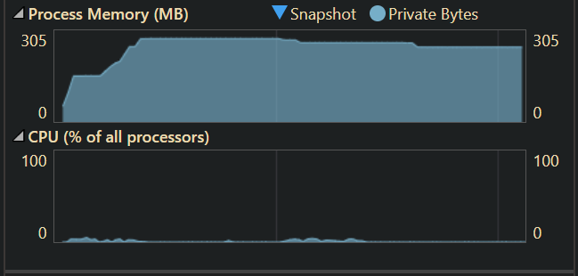
Instancing
Originally planned to be implemented into the model renderer as a method. Extracting out into its own renderer was more feasible for the code structure.
By passing in the instance umber this sets up the vertices that will populate the mat4 offsets and then draw multiple trees in one call.
Instancing improves performance by passing all the information of a daw call in one pass rather than each individual model.
Fig 11.0: Before instancing 20 Trees
Fig 11.0: After instancing 20 Trees

Slide 17
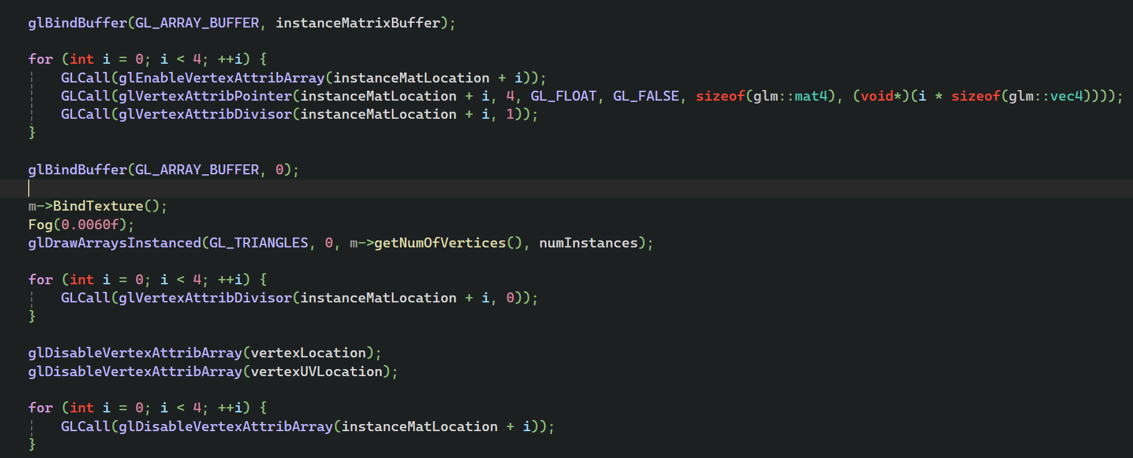
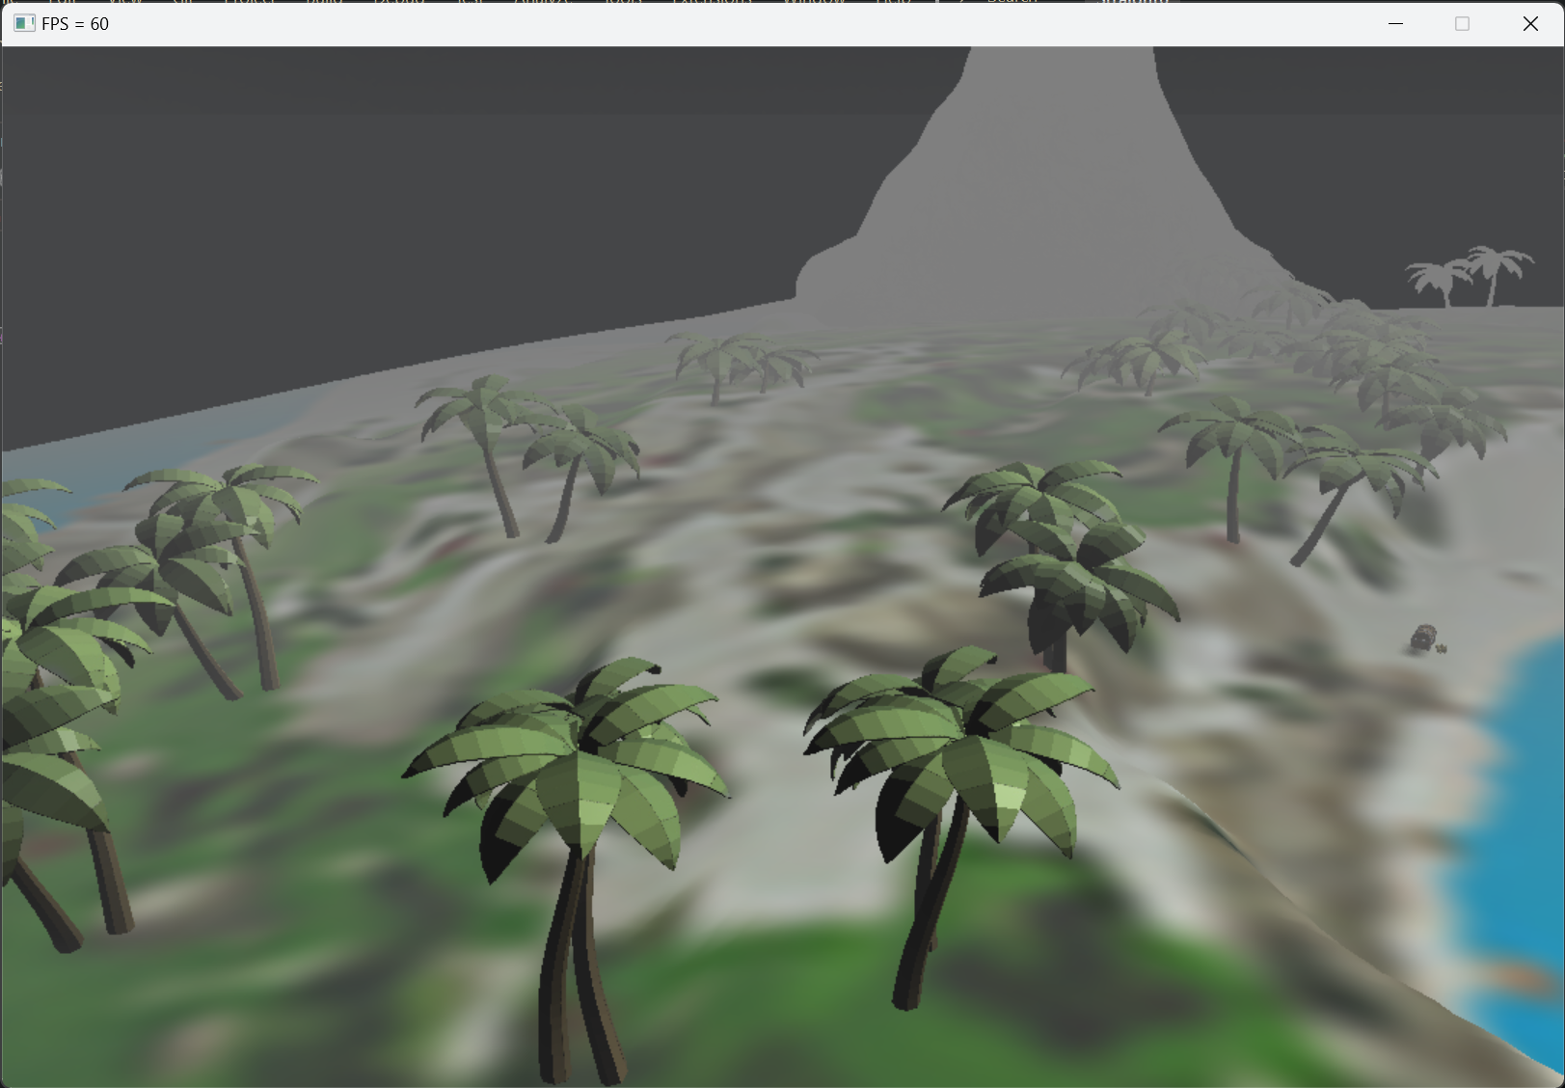
Instancing
Fig 12.0: Instancing trees

Slide 18
Particle System
First a definition of a particle and its data are made and then managed by the emitter, Lifetimes, size, opacity and locations are updated per particle
They are positioned in ascending z order for accurate blending
Some trial and error around adequate particle amounts found me at 20 or so particles for a good result

Slide 19
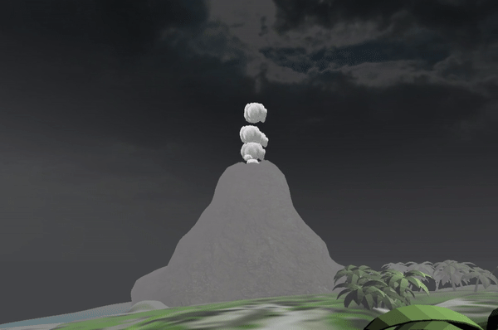
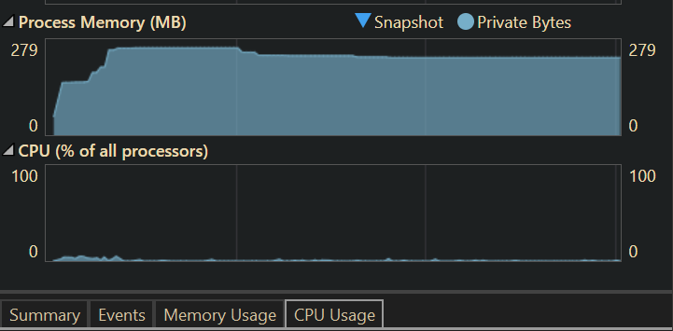
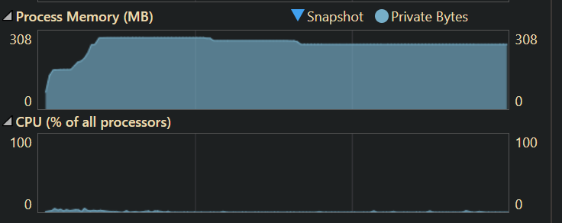
Particles
Fig 13.1: Instanced
Fig 13.1: Non-instanced
Fig 13.0: Volcano smoke particles

Slide 20
Lighting & shadows
Shadows were added to the scene using shadow mapping techniques and frame buffers with the depth only component
By rendering the scene to a depth buffer first and then applying this to the scene after the colour is added
A test against the camera and light distance from a fragment determines weather or not it is in shadow
To reduce aliasing on the shadows, percentage closer fill is used to make a softer shadow n the edge

Slide 21
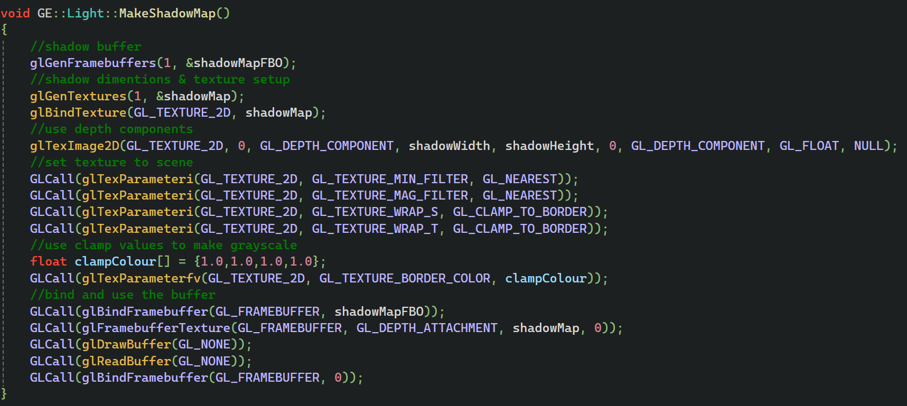
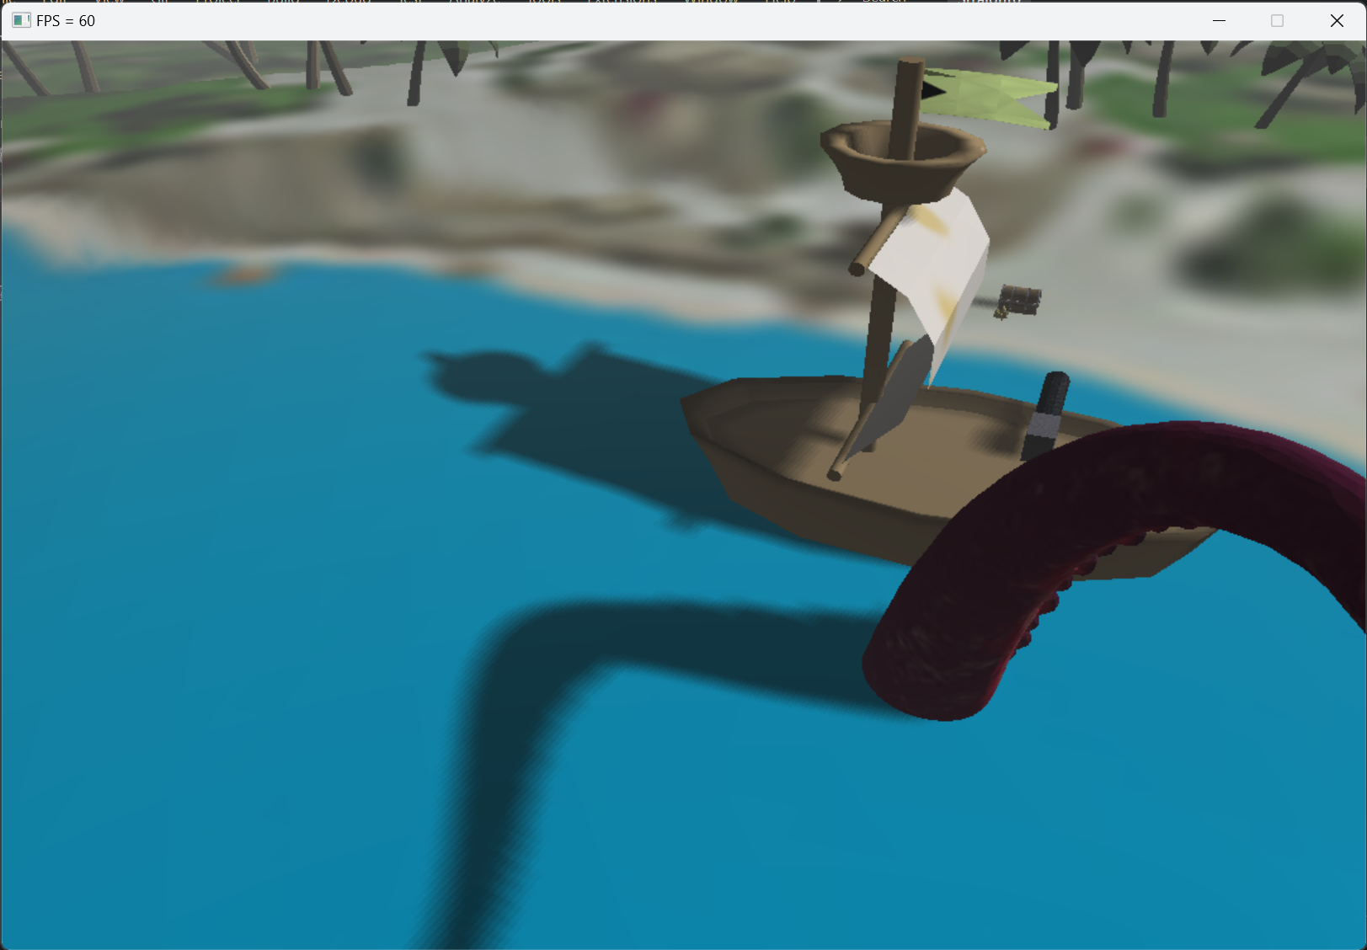
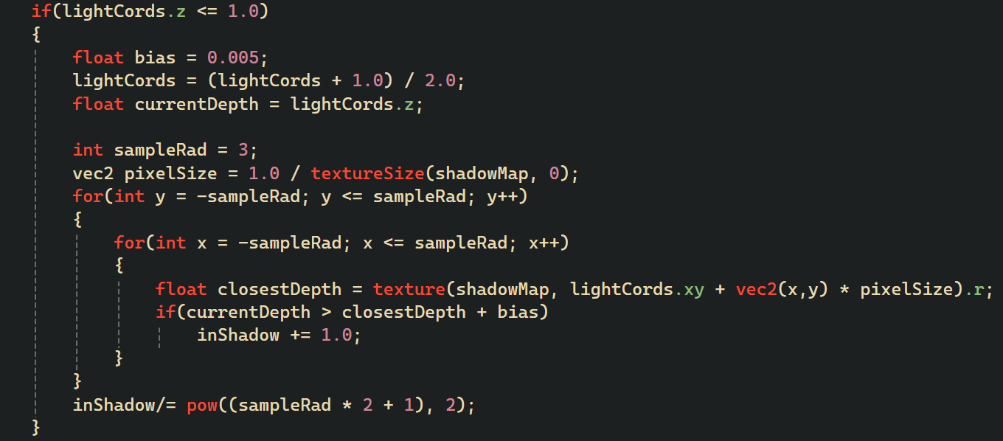
Lighting & shadows
Fig 13.0: Shadow mapping

Slide 22
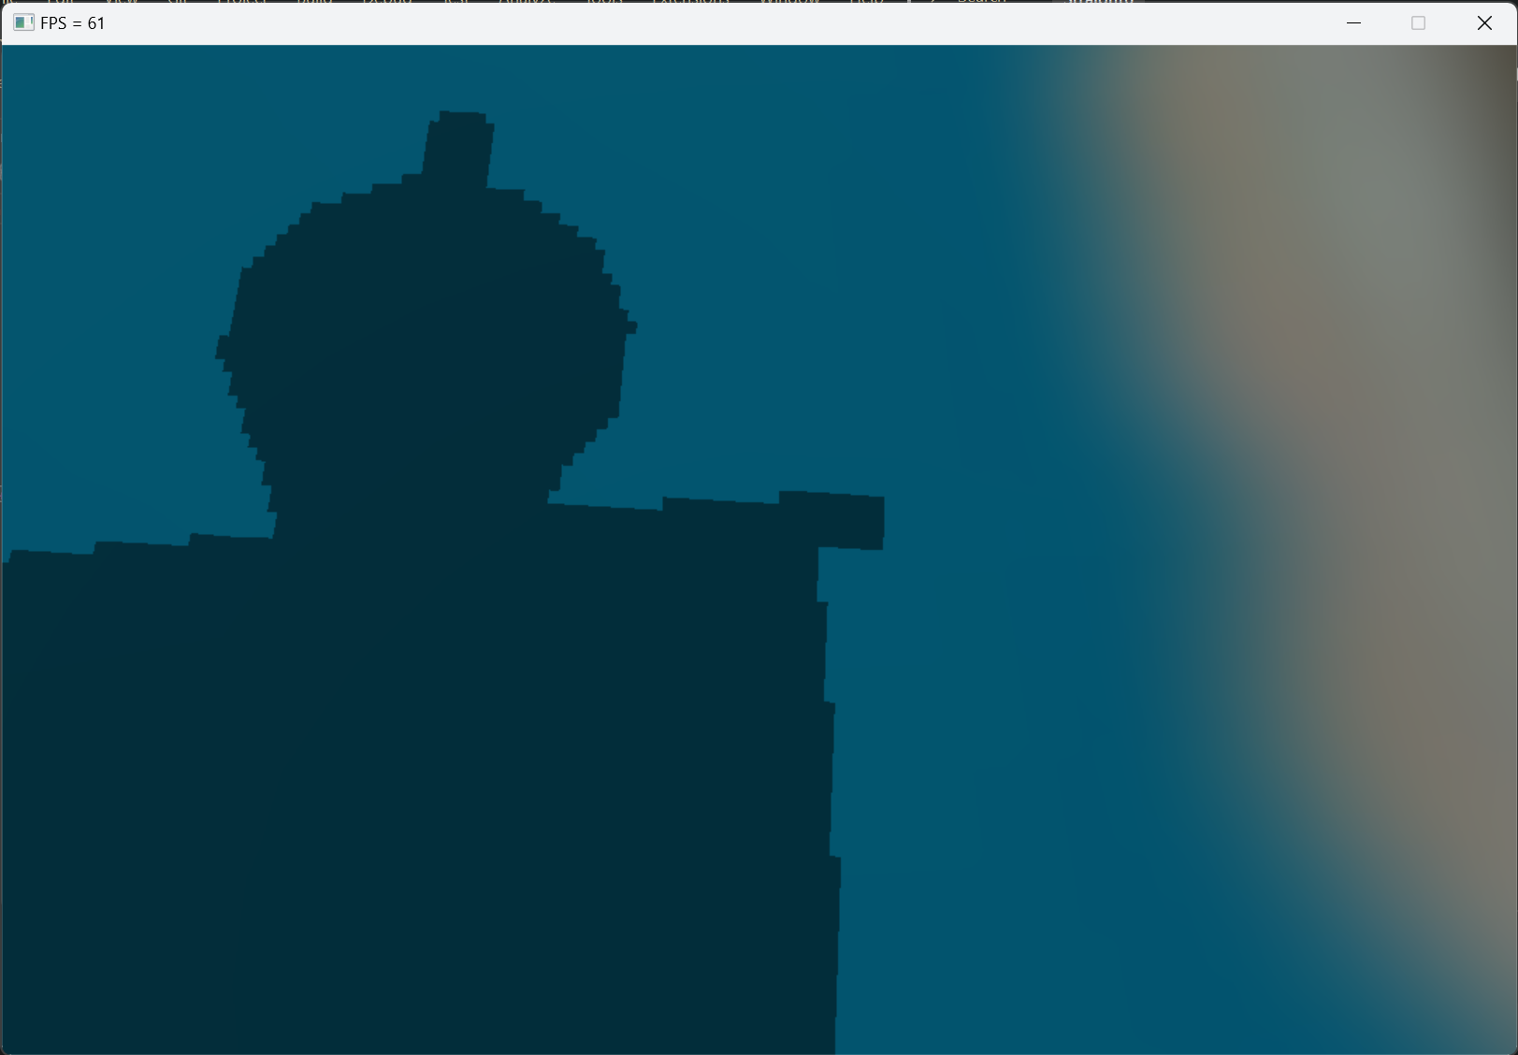
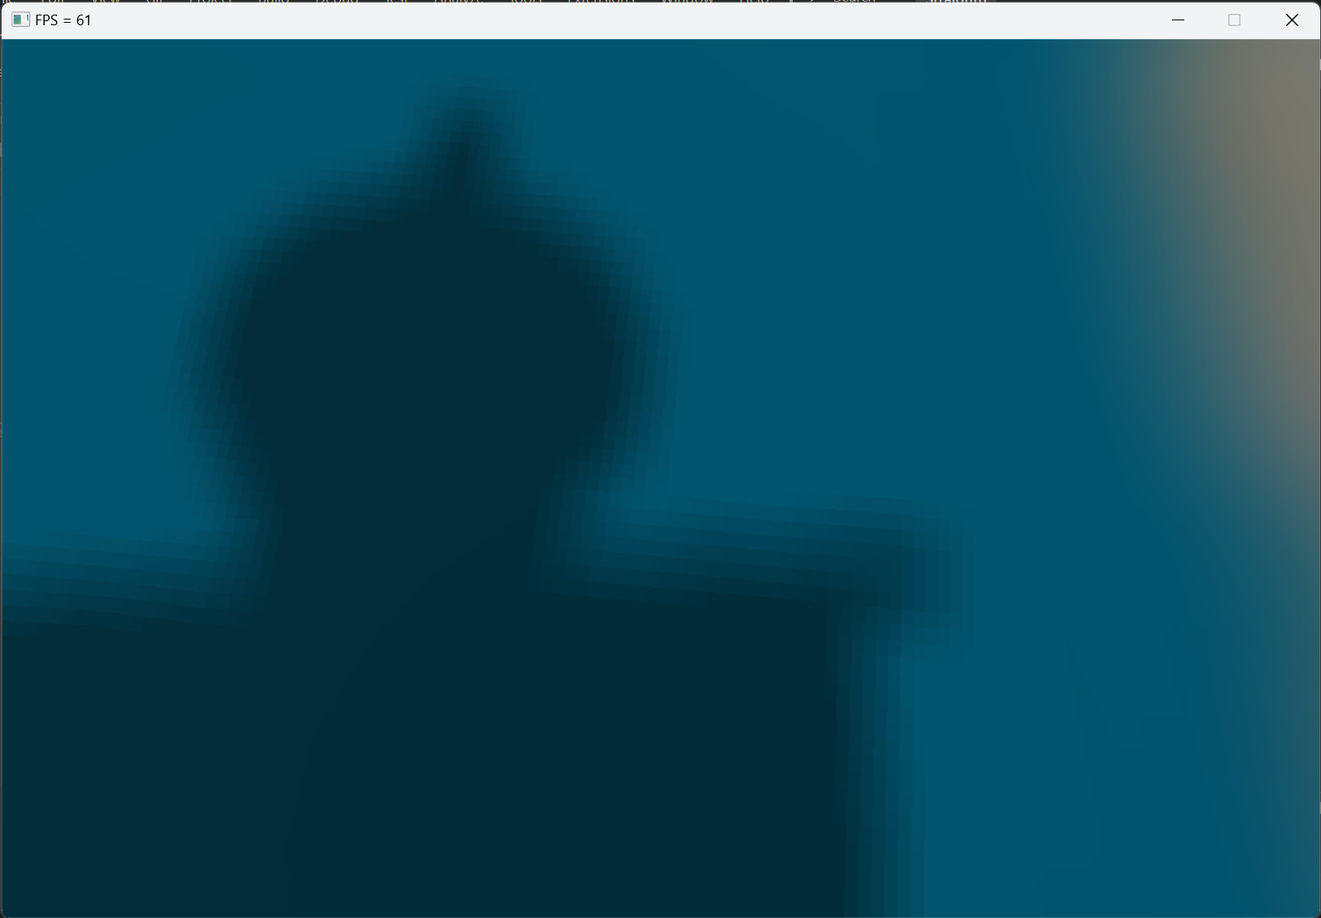
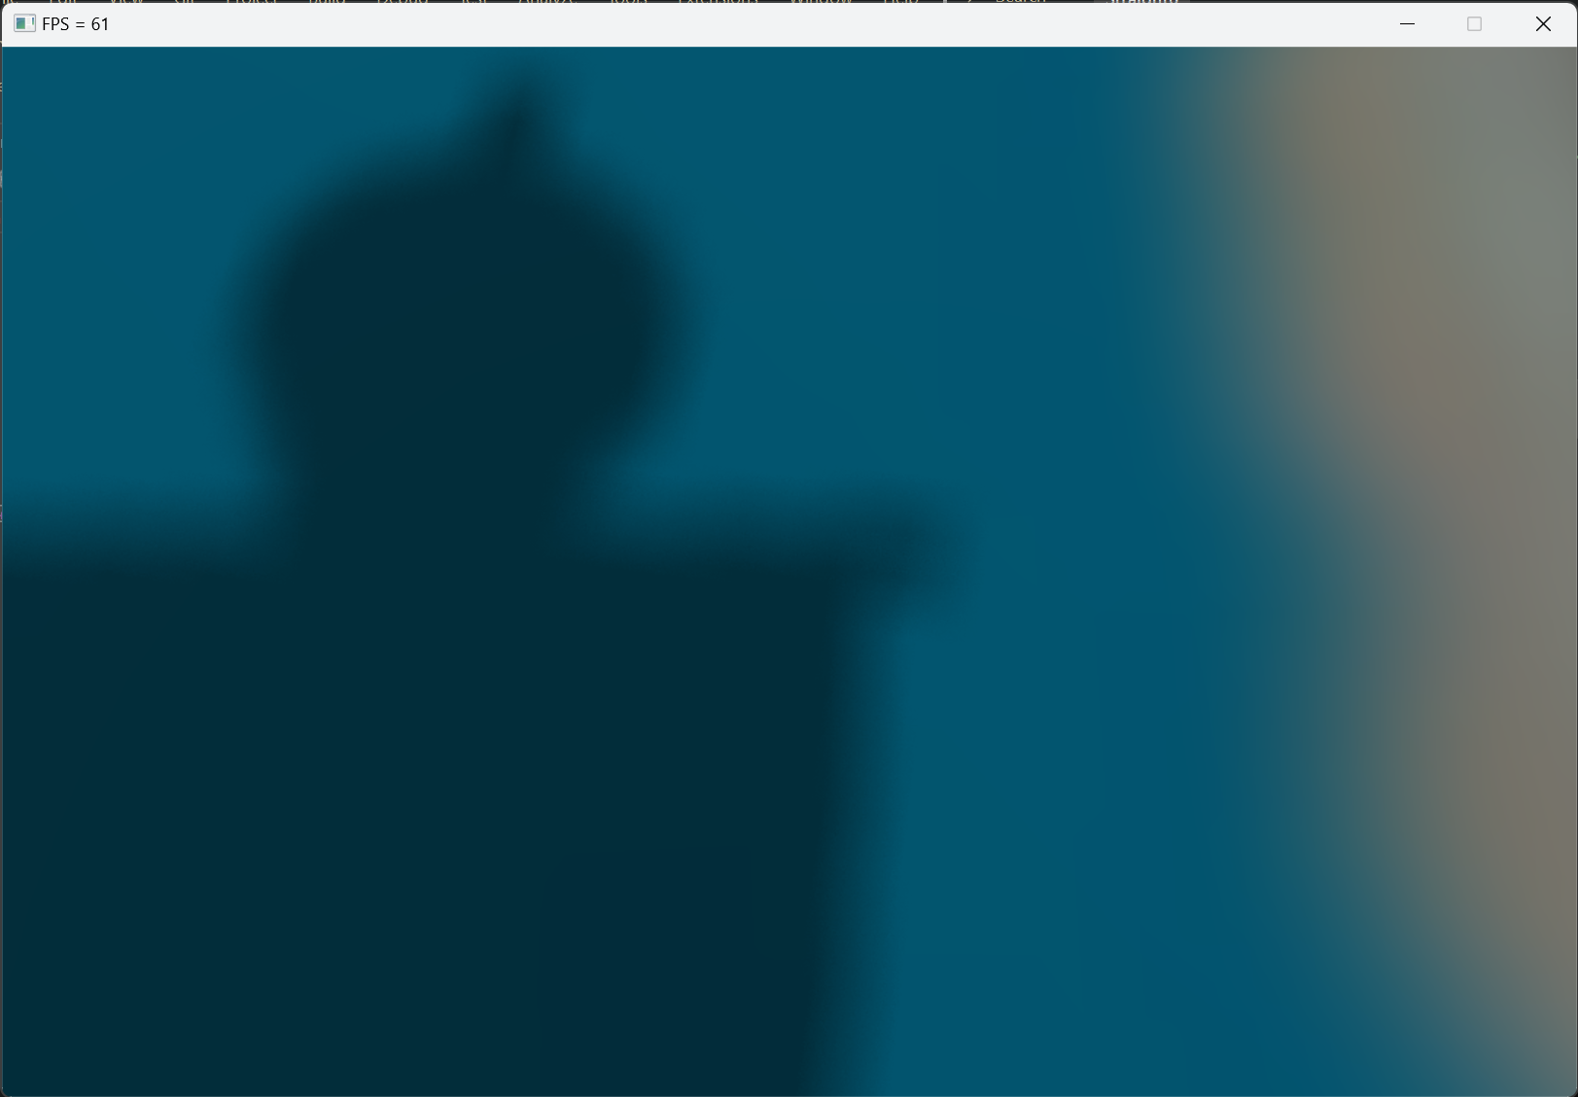
PCF results
Fig 14.0: Shadow mapping no PCF
Fig 14.1: Shadow mapping with PCF
Fig 14.2: Shadow mapping with random sampling

Slide 23
Thank you for listening
Onto the Demo.

